Slide 1
Chapter-5
Financial Assets valuation (N 10 to 12 marks)

Slide 2
Concept of bond ( Part I)
It is long term sources of financing or long term promissionary note issued by a government or corporation.
it is one of the popular debt capital instrument of long term financing.
It is long term contract between company ie issuer and investor,in which contract one parties agree to pay regular interest and principal pay at the end of maturity.
The bond issuer must prepare a bond indenture while issuing a bond. Bond indenture is a legal document that contains terms and condition of bond issues.
There are many types of bond like corporate bond,government, bond,municipal bond ,foreign bond etc
Bond’s par value is usually set at Rs 1000.
The value of bond depend upon coupon interest rate, market interest rate, maturity period.

Slide 3
Features of bond
The features of the bonds are explain by following points.
1. Face value:-
The par value is the stated face value of the bond, which is paid at maturity. It is also called maturity value or face value or pricipal. It is usually is set at Rs 1000 per bond.
2. Coupon interest rate:-
The coupon rate is the fixed interest rate which bondholders are paid at the end of each period.
3. Maturity period:-
Maturity date is the specified date on which the principal amount ie par value is repaid.the number of year to maturity at the time a bond is issued is known as orginal matutity.
4. Indenture:-
An indenture is a legal document or contract that contains terms and condition of bond issue. It includes details of debt issue, description of property ,pledged, the method of principal repayment ,restrictions rights and responsibilities of both borrower and lender.

Slide 4
5. Call provision:-
A call provision is the special provision in the bond that gives the issuer the right to call the bonds prior to maturity
6. Sinking Fund provision:-
Sinking fund provision is a special provision in a bond contract that facilities the orderly retirement of the bond.in some casues, the firm may be required to deposit money with trustee, which invests the funds and then uses the accumulated sum to redeem the bonds at maturity.
7. Convertibility:-
Bond also has the features of convertibility into equity shares at the option of the bondholders within a specified period and at a specified conversion ratio.this additional feature is added with a view to make the bond popular. In case of nepal, the bond issued by sirram sugar mills was convertible bond.

Slide 5
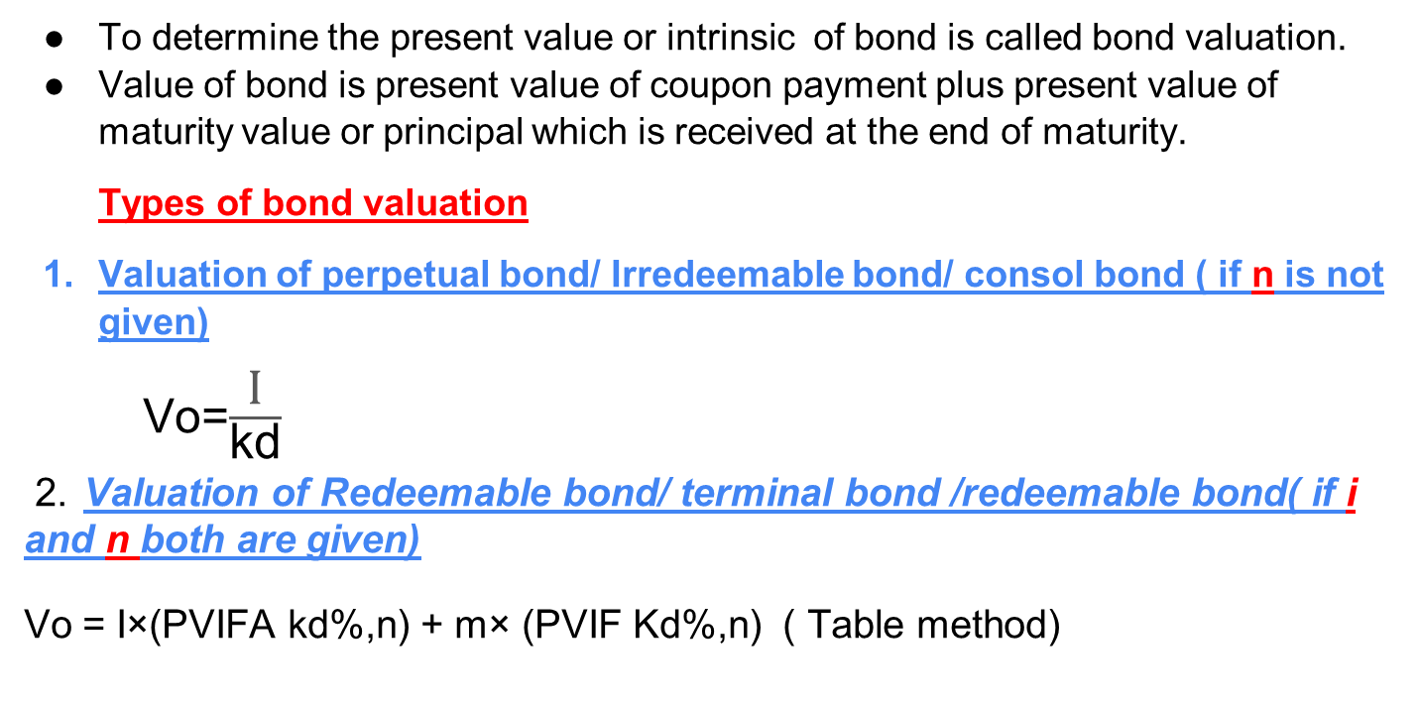
Bond Valuation i.e Vo =?
To determine the present value or intrinsic of bond is called bond valuation.
Value of bond is present value of coupon payment plus present value of maturity value or principal which is received at the end of maturity.
Types of bond valuation
Valuation of perpetual bond/ Irredeemable bond/ consol bond ( if n is not given)
Vo=$\frac{\text{I}}{\text{kd}}$
2. Valuation of Redeemable bond/ terminal bond /redeemable bond( if i and n both are given)
Vo = I×(PVIFA kd%,n) + m× (PVIF Kd%,n) ( Table method)

Slide 6
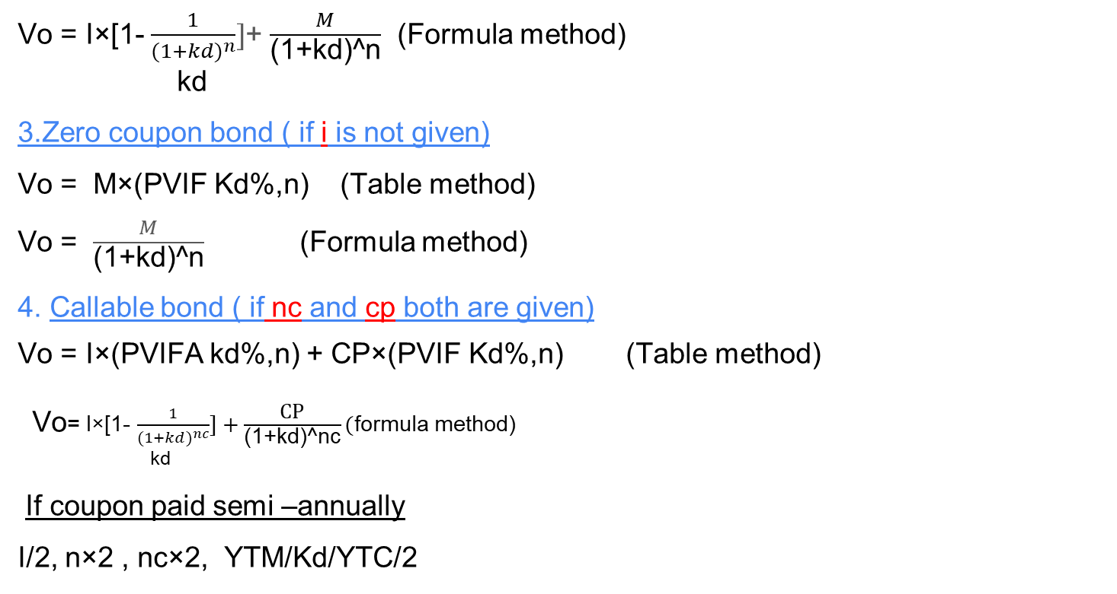
Vo = I×[1- $\frac{1}{(1+k{d)}^{n}}]$+ $\frac{M}{\text{(}\text{1}\text{+}\text{kd}\text{)^}\text{n}}$ (Formula method)
kd
3.Zero coupon bond ( if i is not given)
Vo = M×(PVIF Kd%,n) (Table method)
Vo = $\frac{M}{\text{(}\text{1}\text{+}\text{kd}\text{)^}\text{n}}$ (Formula method)
4. Callable bond ( if nc and cp both are given)
Vo = I×(PVIFA kd%,n) + CP×(PVIF Kd%,n) (Table method)
Vo= I×[1- $\frac{1}{(1+k{d)}^{nc}}]+\frac{\text{CP}}{\text{(}\text{1}\text{+}\text{k}\text{d}\text{)^}\text{nc}}($formula method)
kd
If coupon paid semi –annually
I/2, n×2 , nc×2, YTM/Kd/YTC/2

Slide 7
M = par value/ face value/ maturity value
i= coupon interest rate ie (beginning interest rate)
n= maturity period/ Time period
nc= call period /call year
CP= call price ie ( CP=par value + premium)
Kd/YTM = market interest rate/ going rate of interest/ required rate of return/ discount rate/ Yield To Maturity
Vo= value of bond today/ present value of bond/ Intrinsic value of bond
Conditions
If M > Vo Discount bond
If M < Vo premium bond
If M = Vo par bond

Slide 8
Decision:-
1.if intrinsic value of bond ie calculated value > Market price of bond ie given value
Undervalued buy the bond
2. .if intrinsic value of bond ie calculated value < Market price of bond ie given value
overvalued sell the bond
3. if intrinsic value of bond ie calculated value = Market price of bond ie given value
equal valued No action

Slide 9
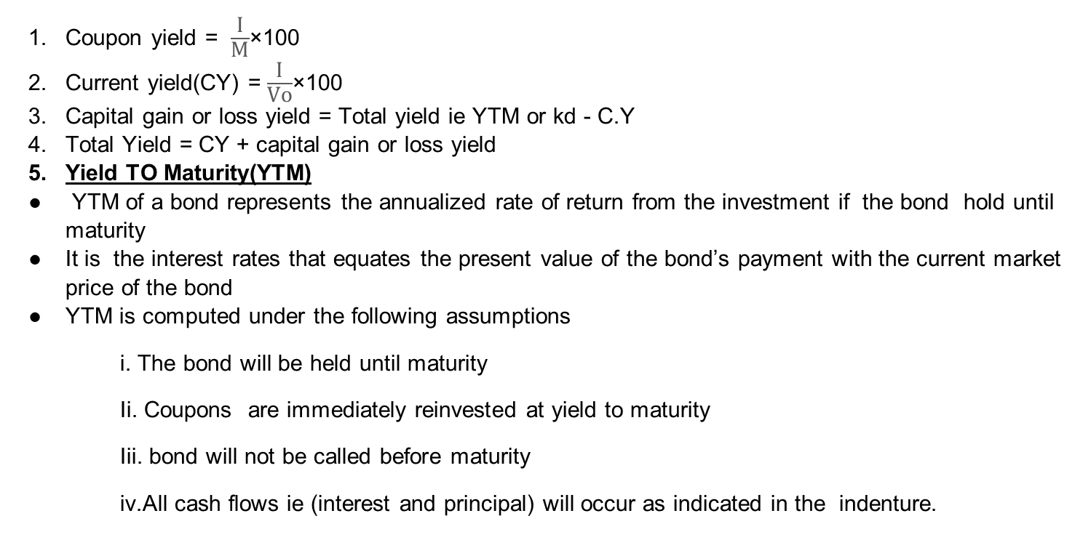
Bond return measures
Coupon yield = $\frac{\text{I}}{\text{M}}$×100
Current yield(CY) = $\frac{\text{I}}{\text{Vo}}$×100
Capital gain or loss yield = Total yield ie YTM or kd - C.Y
Total Yield = CY + capital gain or loss yield
Yield TO Maturity(YTM)
YTM of a bond represents the annualized rate of return from the investment if the bond hold until maturity
It is the interest rates that equates the present value of the bond’s payment with the current market price of the bond
YTM is computed under the following assumptions
i. The bond will be held until maturity
Ii. Coupons are immediately reinvested at yield to maturity
Iii. bond will not be called before maturity
iv.All cash flows ie (interest and principal) will occur as indicated in the indenture.

Slide 10
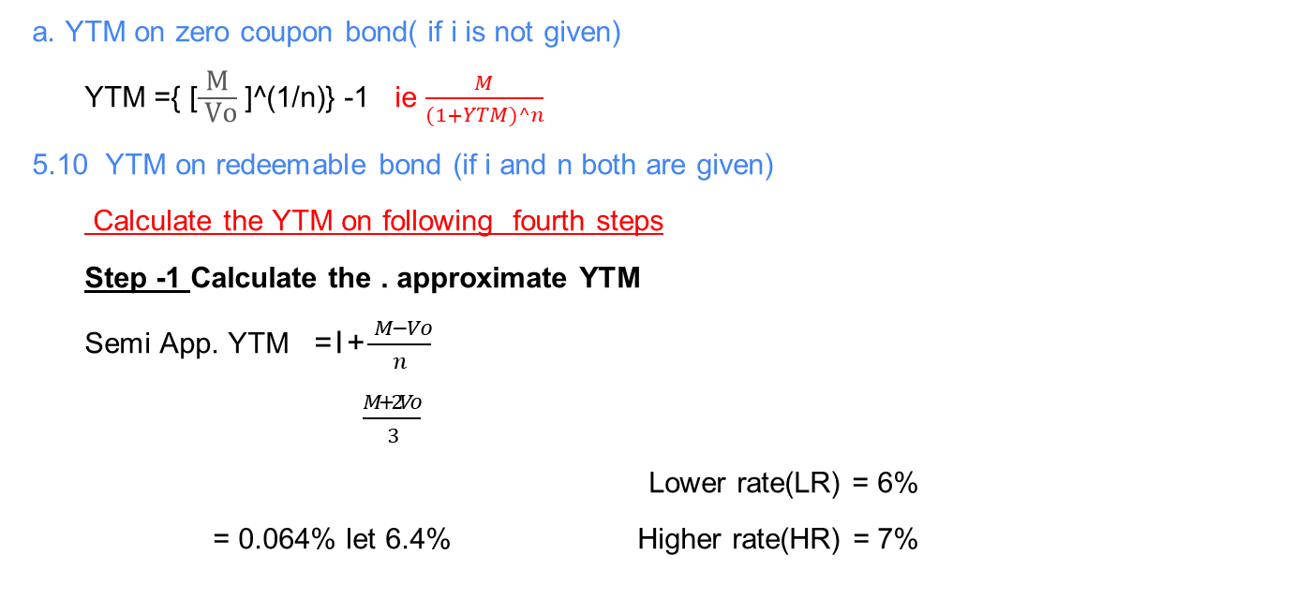
Calculate the YTM on following ways
a. YTM on zero coupon bond( if i is not given)
YTM ={ [$\frac{\text{M}}{ \text{Vo}}$ ]^(1/n)} -1 ie $\frac{M}{(1+YTM)^n}$
5.10 YTM on redeemable bond (if i and n both are given)
Calculate the YTM on following fourth steps
Step -1 Calculate the . approximate YTM
Semi App. YTM = I + $\frac{ M−Vo}{n}$
$\frac{M+2Vo}{3}$
Lower rate(LR) = 6%
= 0.064% let 6.4% Higher rate(HR) = 7%

Slide 11
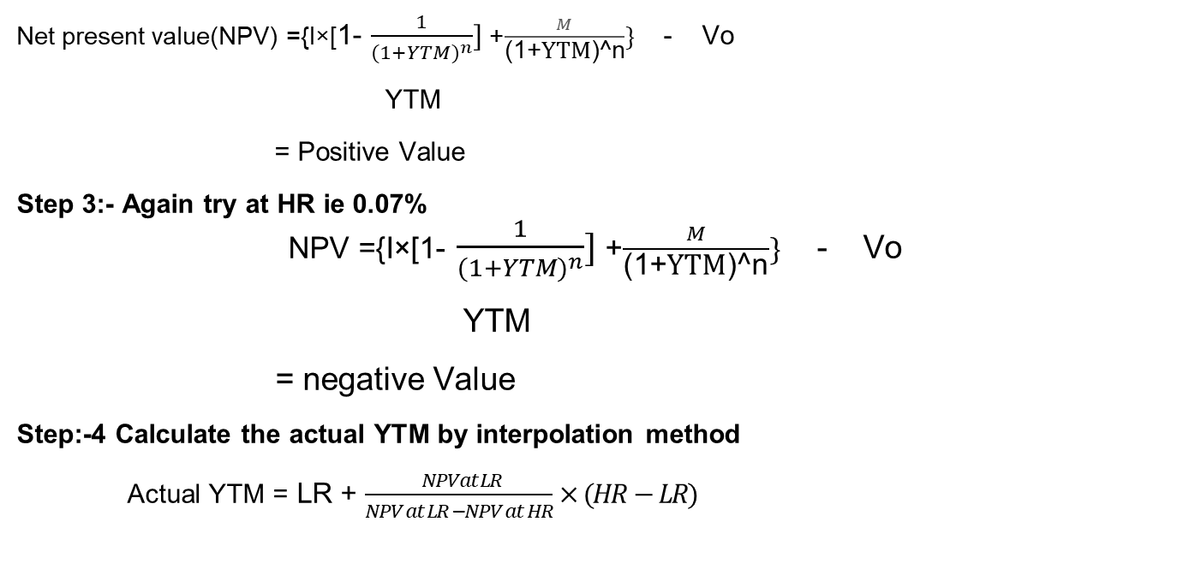
Step 2:- Try at LR ie 6% or 0.06
Net present value(NPV) ={I×[1- $\frac{1}{(1+YTM)^{n}}]$+ $\frac{M}{\text{(}\text{1}\text{+}\text{YTM}\text{)^}\text{n}}\}$ - Vo
YTM
= Positive Value
Step 3:- Again try at HR ie 0.07%
NPV ={I×[1- $\frac{1}{(1+YTM)^{n}}]$+ $\frac{M}{\text{(}\text{1}\text{+}\text{YTM}\text{)^}\text{n}}\}$ - Vo
YTM
= negative Value
Step:-4 Calculate the actual YTM by interpolation method
Actual YTM = LR + $\frac{ NPVat LR}{NPV at LR −NPV at HR}×(HR−LR)$

Slide 12
6. Yield To Call (YTC)
YTC is the annualized rate of return that an investor would earn if he/she bought a callable bond at its current market price and held it until the call date given that the bond was called on the date.
YTC is also known as yield to first call
YTC is computed under following the assumption
i.The bond will be held to call date.
ii.Coupons are reinvested at the yield to call date.
Iii. The issuer calls the bond on the call date.
YTC is calculated on following fourth steps

Slide 13

Step -1 Calculate the approximate YTC
App. YTC= I + (CP – Vo)/ nc
(CP + 2Vo)/3 Lower rate(LR) = 9%
= ……% let 9.5% Higher rate(HR) =10%
Step 2:- try at LR ie 9%
Net present value(NPV) ={ I×[1- $\frac{1}{(1+YTC)^{nc}}]+\frac{\text{CP}}{\text{(}\text{1}\text{+}\text{YTC}\text{)^}\text{nc}}\}$ -Vo
YTC
= Positive Value
Step 3:- Again try at HR ie 10%
NTV = I×[1- $\frac{1}{(1+YTC)^{nc}}]+\frac{\text{CP}}{\text{(}\text{1}\text{+}\text{YTC}\text{)^}\text{nc}}$ - Vo
YTC
= negative value
Step:-4 calculate the actual YTC by interpolation method
Actual YTC =LR +$\frac{ NPVat LR}{NPV at LR −NPV at HR}×(HR−LR)$

Slide 14
7. Effective annual YTM
= (1+ semi annual YTM)^2 -1

Slide 15
Part II
Stock Valuation

Slide 16
Concept of Common stock
Common stock is a security issued by a company to raise equity capital.
It is one of the major sources of long term capital.
Common stock represent ownership of the company.
Common stockholders of a company are its real stockholders have residual claim on income and asset.
Its dividend is paid after payment of interest to the creditors, tax to the government and preferred dividend to the preferred stockholders.
In the event of liquidation, common stockholders have a residual claim on the assets of the company after the claim of all creditors and preferred stockholders are settled in full.

Slide 17
Features of Common stock
i par value
ii. No fixed maturity period
iii. No fixed dividend
iv. Voting right
v. Claim on income and assets
vi. preemptive rights
vii. Limited liabilities

Slide 18
Common stock Valuation i.e Po =?
To determine the present value or intrinsic value of stock is call common stock valuation.
1. Dividend Valuation Model (DDM):-(Base on dividend)
2. Economic Value Added Model(EVAM):- (Base on free cash flow)
Under DDM
Valuation of zero growth model
Po = $\frac{\text{D}0}{\text{ks}}$ =Rs…
ii. Constant/ normal growth model
Po = $\frac{\text{D}0(1+gn)^1}{\text{(}\text{ks} \text{− }\text{gn}\text{)}}$ or Po = $\frac{\text{D}\text{1}}{\text{(}\text{ks} \text{− }\text{gn}\text{)}}$ = Rs…

Slide 19
iii. Non constant /supernormal growth model ( if company grow a dividend rapid or dividend grow for next two year ,next three is given)
Now
Po = $\frac{\text{D}\text{1}}{\text{(}\text{1}\text{+}\text{ks}\text{)^}\text{1}}$ + $\frac{\text{D}2}{\text{(}\text{1}\text{+}\text{ks}\text{)}\text{^}2}$ +………+ $\frac{\text{D}n}{\text{(}\text{1}\text{+}\text{ks}\text{)}\text{^}n}$ + $\frac{\text{P}n}{\text{(}\text{1}\text{+}\text{ks}\text{)}\text{^}n}$ = Rs…
working note
Supernormal end year i.e n =……
D1 = Do(1+gs)^1
D2 = D1 (1+gs)1
Dn = Dn-1(1+gs)1
Pn = $\frac{\text{D}n(1+gn)^1}{\text{(}\text{1}\text{+}\text{ks}\text{)}\text{^}n}$
Where,
Po = intrinsic value of stock/ market price of stock/ selling price of stock/ present value of stock
Do= Current year/ just paid/ last dividend/just paid /recent dividend
D1 = expected/ year end / next year dividend
gn= constant / normal / steady growth rate
gs= supernormal growth rate
Ks = investor’s required rate of return/ expected rate of return

Slide 20
Common stock return measures
1. Dividend yield(DY) = $\frac{D1}{Po}$ ×100
2. Capital gain or loss yield = total yield i.e Ks – DY
3. Total yield =DY + capital gain or loss yield
4. Expected rate of return / required rate of return i.e ks
a. Base on dividend
ks = $\frac{D1}{Po}$ + gn
b. Base on Capital Assets pricing model(CAPM)
ks = Rf + [E(Rm)-Rf)] ×Bs
5. Holding period return(HPR) =$\frac{P1 −P0+D1}{Po}$ ×100
where,
Rf = risk free rate
E(Rm) = expected/ average market return
Bs = beta of stock
[E(Rm)-Rf)]= Risk premium

Slide 21
Preferred stock
Preferred stock also called preference share, represents the long term sources of financing.
it occupies an intermediate position between long term debt and common stock. In the event of liquidation, a preferred stockholder’s claim on assets comes after that of creditors but before that of common stockholders.
preferred stock is a hybrid form of financing with combined features of both debt and common stock.
preferred stock dividend are fixed in amount and no voting right.
preferred stock are often callable.

Slide 22
Features of preferred stock
Par value
Fixed dividend
Fixed maturity period
No voting right
Call provision
Convertibility

Slide 23
Preferred stock valuations i.e Po=?
Valuation of perpetual preferred stock ( if n is not given)
Po ₌ $\frac{\text{D}p}{\text{kp}}$×100
2. Valuation of redeemable preferred stock(if Dp and n both are given)
Po = Dp× ( PVIFA kp%,n) + M× (PVIF kp%,n) ( Table method)
Po = Dp ×[1- $\frac{1}{(1+k{p)}^{n}}]$ + $\frac{\text{M}}{\text{(}\text{1}\text{+}\text{kp}\text{)^}\text{n}}$ (Formula method)
kp
3. Valuation of callable model ( if nc and cp are given)
Po = Dp ×{1- $\frac{1}{(1+k{p)}^{nc}}$} + $\frac{\text{C}P}{\text{(}\text{1}\text{+}\text{kp}\text{)^}\text{nc}}$ (Formula method)
kp
Po = Dp× ( PVIFA kp%,nc) + CP× (PVIF kp%,nc) ( Table method)
Where,
Dp = Dividend on preferred stock
Kp = required rate of return on preferred stock

Slide 24
THE END

